Slide 2
Objectives
Understand what is meant by an output device
Understand each of the following output devices and why they are required
Speakers
Light emitting diode (LED) screens
Liquid crystal display (LCD) projectors
Liquid crystal display (LCD) screens
Digital light processing (DLP) projectors
Actuators

Slide 3


Starter
Think about the computers and devices you use
What output devices do they use to interact with you?

Slide 4
Starter
Output devices transfer data produced by a computer and turn it into a human-readable form
Examples include:
Displays and projectors
Printers
Speakers
Actuators

Slide 5

Speakers and headphones
Digital data is sent from the computer to a Digital to Analogue Converter (DAC) where it is converted into an analogue signal
The signal is then boosted using an amplifier and finally sent to a speaker

Slide 6

Actuators
Actuators are output devices used to move mechanisms or systems
One example of where an actuator is used would be an automatic door to a supermarket
Give at least three other examples where actuators may be used

Slide 7
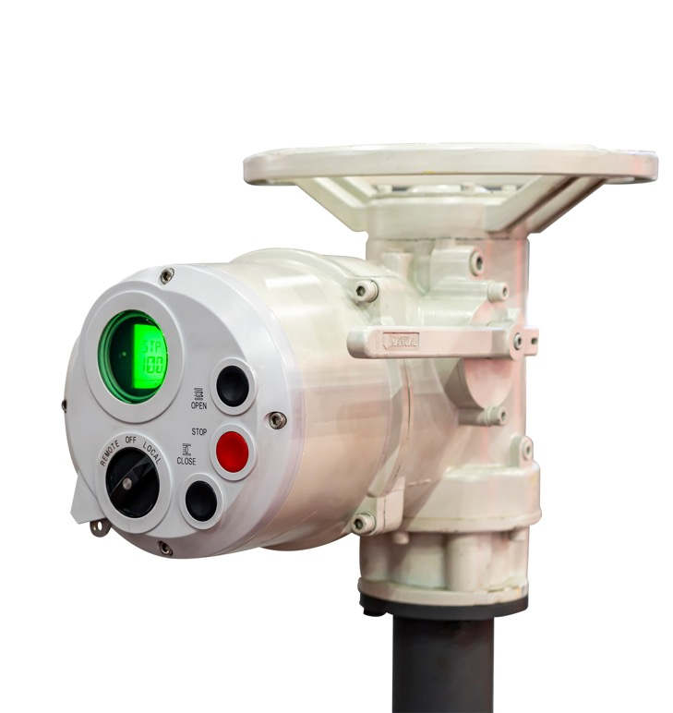
Actuators
Some examples include:
Central locking on cars
Opening and closing valves on pipes
Each part of a robotic arm will have an actuator to rotate it
Food and drink manufacturing
Moving the head of a 3D printer

Slide 8
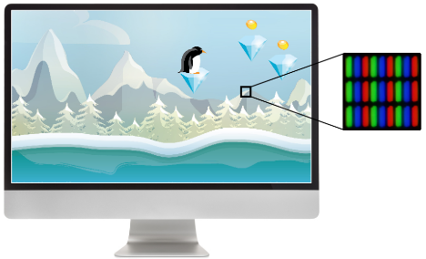
LCD screens
Liquid Crystal Display (LCD) screens are made from millions of pixels
Each pixel is effectively a separate red, blue or green light that can be switched on or off electronically using liquid crystals to rotate polarised light
The pixels are switched on or off very rapidly to make the moving colour picture

Slide 9
LED screens
LED screens are very similar to LCD screens
LCD screens are backlit with a fluorescent backlight
LED screens use LEDs (light emitting diodes) to light them, but an LCD film is still used to turn the pixel colours on or off

Slide 10
LED versus LCD screens
Using LEDs to back-light LCD screens has a number of advantages over the older fluorescent technology:
They reach their maximum brightness almost immediately
The image is sharper with more realistic and vivid colours
They produce a brighter light which leads to better picture definition
Since LEDs are very small, this allows the screens to be much thinner in construction
They last almost indefinitely which makes the screens much more reliable
They consume very little power and therefore produce very little heat and reduce running costs

Slide 11
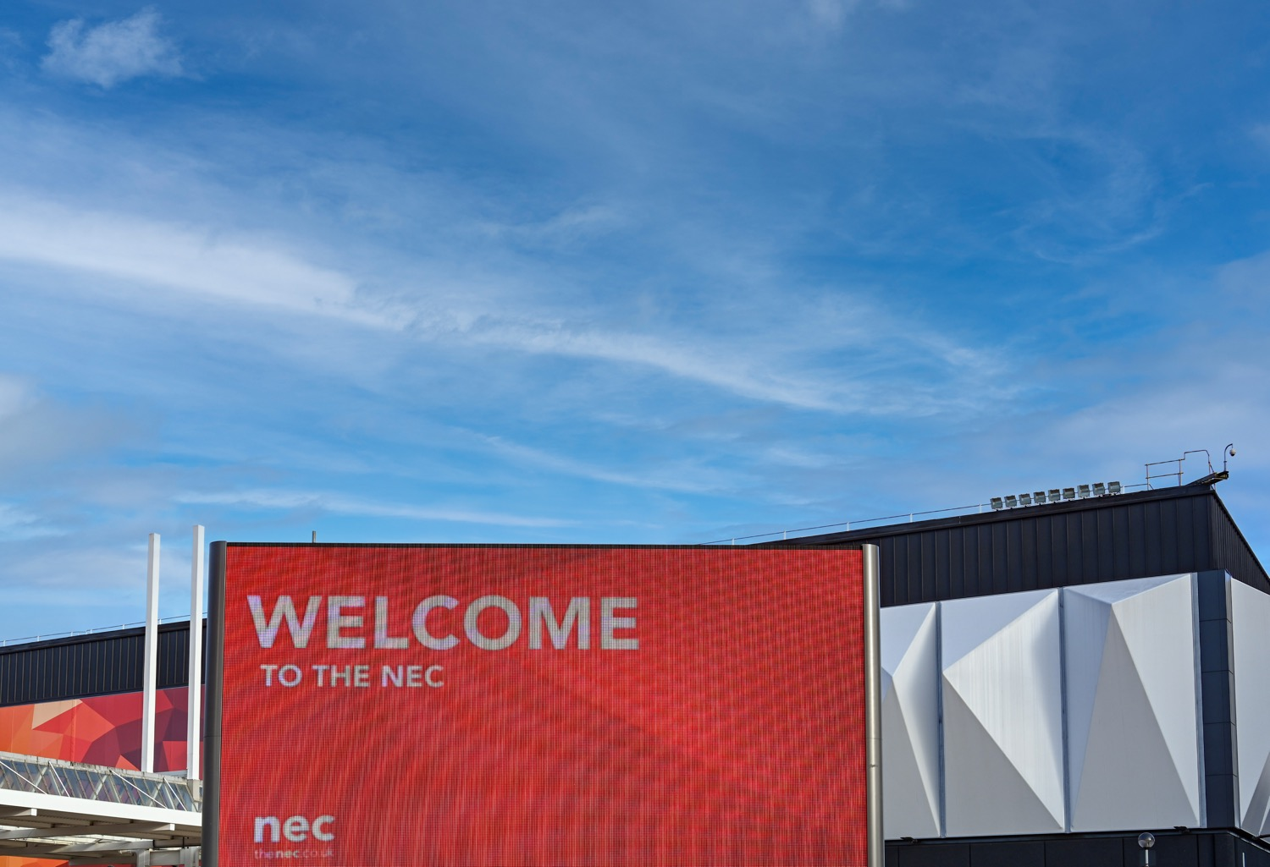
LED screens
Giant LED screens use LEDs for each individual sub-pixel
They are very bright, so suitable for use outside in the day
Many individual modules are combined together to build the screen, so they are perfect for festivals and music events

Slide 12
Worksheet 4
Complete Task 1 on Worksheet 4

Slide 13
DLP projectors
DLP (digital light processing) projectors use millions of micro-mirrors on a small microchip within the projector (each mirror corresponds to a single pixel)
When these micro-mirrors are tilted towards the light source, they are in the ‘on’ status
If they are tilted away from the light source, they are in the ‘off’ status
The micro-mirrors can switch between ‘on’ and ‘off’ thousands of times a second creating different and changing shades of grey light

Slide 14
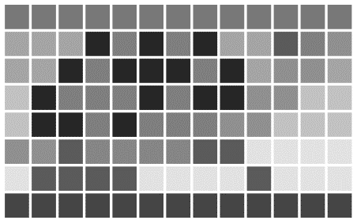
Using grey light
DLP projectors use a grid of mirrors that can each produce over a thousand shades of grey
If a micro-mirror is in the ‘on’ status more than it is in the ‘off’ status, then it produces a lighter shade of grey – if it’s the other way round, then a darker shade of grey is produced
This creates a greyscale video image using grey ‘mirror’ pixels

Slide 15
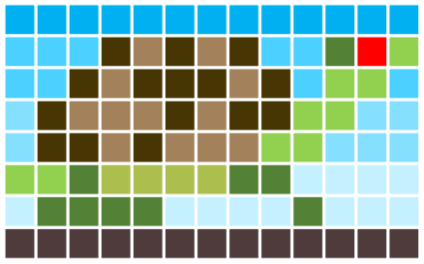
Adding colour with DLP
A strong white light passes through colour filters on a rapidly spinning wheel which converts it into red, green or blue light
A filtered green light shone onto a tilted ‘off’ mirror reflecting dark grey light, projects a dark green pixel
A purple pixel is created by rapidly changing a pixel from blue to red which our brain interprets as blend of the two colours

Slide 16
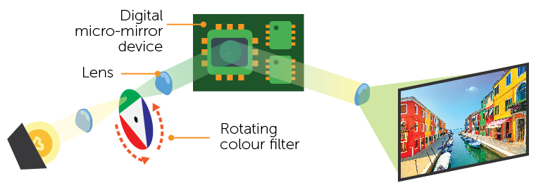
Digital Light Projectors (DLP)
How a DLP projector works
Light source
Projected output

Slide 17
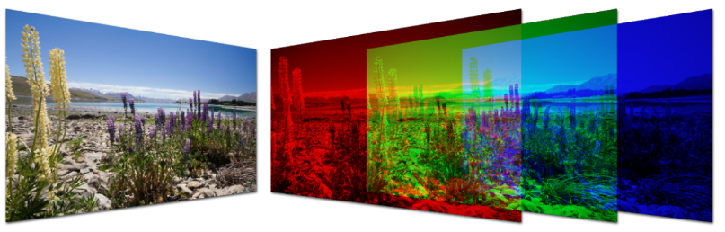
LCD projectors
Like DLP, LCD projectors depend on a very bright source of white light
The white light is sent to Dichroic mirrors and the light is reflected back with red, green or blue wave lengths
The three coloured light components pass through three LCD screens containing the image from the computer to be projected

Slide 18
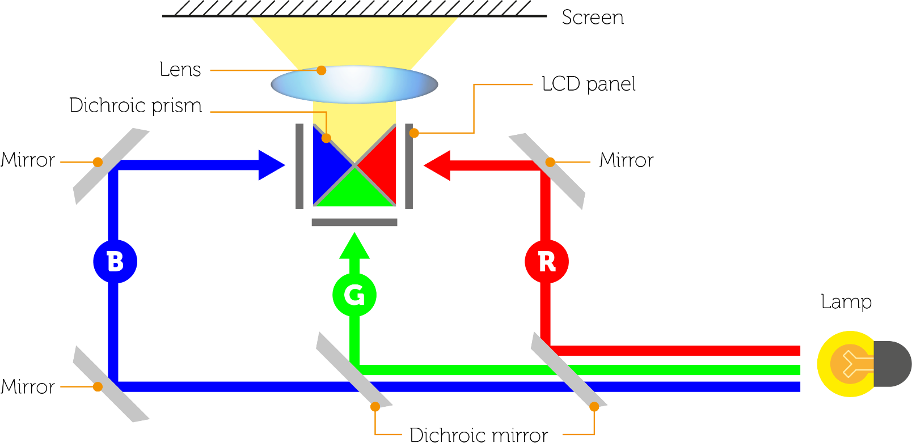
LCD projectors
The three images are then combined using a prism to produce the full colour image which then passes through a lens and is projected on to a screen

Slide 19
Worksheet 4
Complete Task 2 on Worksheet 4

Slide 20
Plenary
Discuss the answers to the following questions with a partner
Explain the differences between an LED screen and an LCD screen
Explain the differences between a DLP projector and an LCD projector
Give four ways in which actuators are used in your life

Slide 21
Plenary
LED and LCD screens
The screens work in the same way, but the backlighting of an LCD screen uses a fluorescent light, whereas an LED screen uses LEDs. Large LED screens use LEDs for each pixel
DLP and LCD projectors
LCD projectors use three LCD screens, one for red, green and blue. The three images are then combined into colour
DLP projectors have a mirror for each pixel and a rotating wheel with the colours red, green and blue
Give four ways in which actuators are used in your life
Automatic doors; car door locks; valve opening on car components; moving a rollercoaster forward and many more

